Slide 1
Deploying PYSpark Applications

Slide 2
Write Spark Application
spark submit

Slide 3
Writing PYSpark Application
PySpark Application to find total time spent on shopping site by each customer.
from pyspark import SparkContext
import sys
if __name__ == "__main__":
sc = SparkContext(appName="UserTimeSpent")
args = sys.argv
inputFileName = args[1] # inputfilename is at 1st index in argv
outputFileName = args[2] # outputfilename is at 2st index in argv
web=sc.textFile("file://" + inputFileName) # Reading file from LocalFS
fields=web.map(lambda x:x.split("\t"))
rdd=fields.map(lambda x:(x[4],int(x[6])))
result=rdd.reduceByKey(lambda x,y:x+y)
result.saveAsTextFile("file://" + outputFileName) # Writingd file to LocalFS

Slide 4
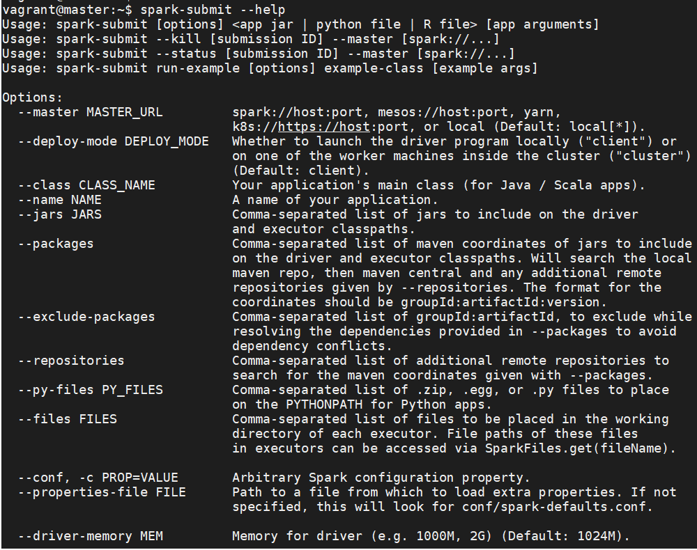
Spark SUbMIT
spark-submit script in Spark’s bin directory is used to launch applications on a cluster

Slide 5
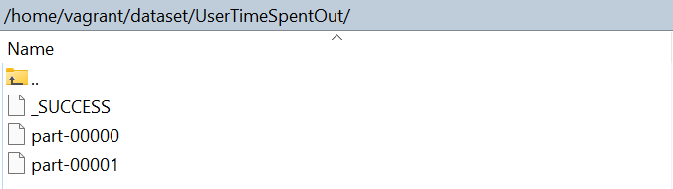
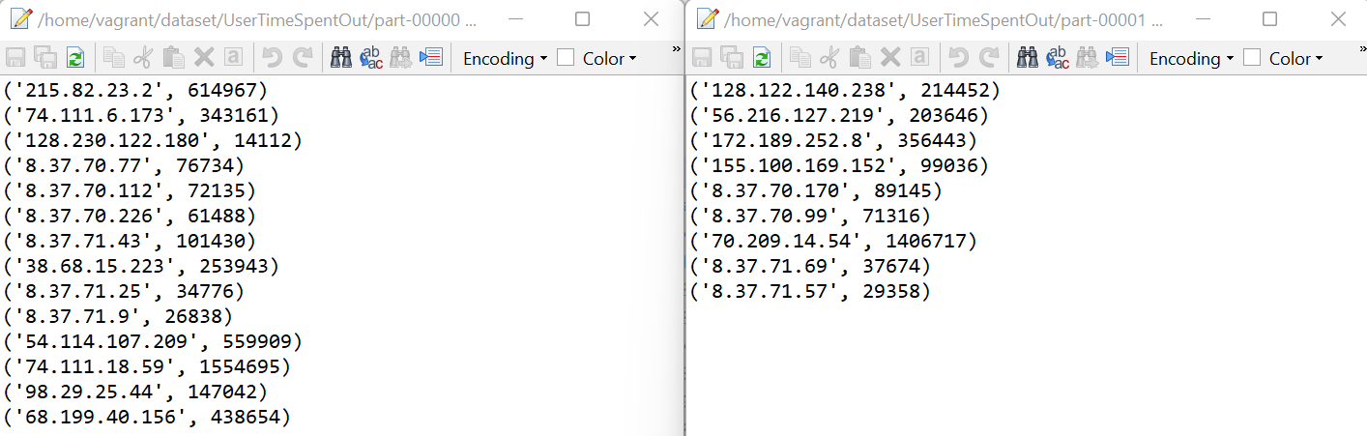
Spark SUbMIT

Slide 6
ubuntu@ip-172-31-68-41:~$ spark-submit --master local[*] /home/ubuntu/Documents/UserTimeSpent.py /home/ubuntu/dataset/sourcedata/webclicksdata/goShopping_WebClicks_medium.dat /home/ubuntu/Documents/usto1

Slide 7
Questions
Notes:
Application Delivery Fundamentals (ADF) 2.0: Testing
Module 02: Introduction to Software Development Life Cycle (SDLC)

Slide 8
Thank You

